Slide 1
UNIT II: Introducing Deep Learning: Biological and Machine Vision, Human and Machine Language, Artificial Neural Networks, Training Deep Networks, Improving Deep Networks.

Slide 2
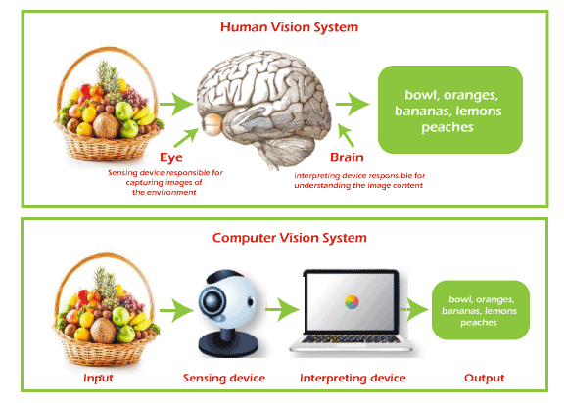

Slide 3
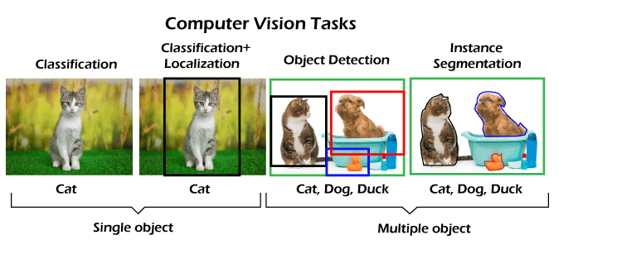

Slide 4
Applications of computer vision
Facial recognition
Healthcare and Medicine
Self-driving vehicles:
Optical character recognition (OCR)
Retail (e.g., automated checkouts)
3D model building:
Medical imaging: E.g., Computed Tomography (CT) or Magnetic Resonance Imaging (MRI) scanner
Automotive safety
Surveillance:
Fingerprint recognition and biometrics:

Slide 5

Human and Machine Language
Human language is a complex and dynamic system of communication used by humans to express thoughts, ideas, and emotions.
Human languages exist in three fields – speech, writing, and gesture
Machine language is a low-level language made up of binary numbers or bits that a computer can understand. It is also known as machine code or object code and is extremely tough to comprehend. The only language that the computer understands is machine language.

Slide 6
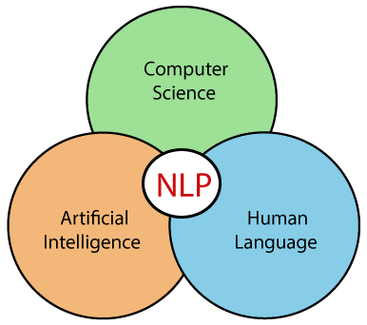
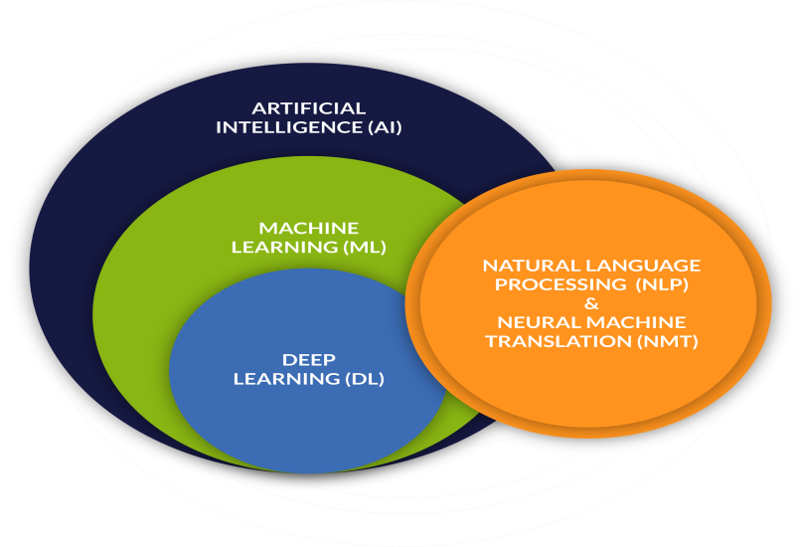
Natural Language Processing
Natural Language Processing (NLP) is a field of Artificial Intelligence (AI) and Computer Science that is concerned with the interactions between computers and humans in natural language. The goal of NLP is to develop algorithms and models that enable computers to understand, interpret, generate, and manipulate human languages.

Slide 7
Natural Language Processing (NLP) is a subfield of artificial intelligence that deals with the interaction between computers and humans in natural language. It involves the use of computational techniques to process and analyze natural language data, such as text and speech, with the goal of understanding the meaning behind the language.
NLP is used in a wide range of applications, including machine translation, sentiment analysis, speech recognition, chatbots, and text classification

Slide 8
Some common techniques used in NLP include:
Tokenization: the process of breaking text into individual words or phrases.
Part-of-speech tagging: the process of labeling each word in a sentence with its grammatical part of speech.
Named entity recognition: the process of identifying and categorizing named entities, such as people, places, and organizations, in text.
Sentiment analysis: the process of determining the sentiment of a piece of text, such as whether it is positive, negative, or neutral.
Machine translation: the process of automatically translating text from one language to another.
Text classification: the process of categorizing text into predefined categories or topics.

Slide 9
Recent advances in deep learning, particularly in the area of neural networks, have led to significant improvements in the performance of NLP systems.
Deep learning techniques such as Convolutional Neural Networks (CNNs) and Recurrent Neural Networks (RNNs) have been applied to tasks such as sentiment analysis and machine translation, achieving state-of-the-art results.
Overall, NLP is a rapidly evolving field that has the potential to revolutionize the way we interact with computers and the world around us.

Slide 10
Working of Natural Language Processing (NLP)
Working in natural language processing (NLP) typically involves using computational techniques to analyze and understand human language. This can include tasks such as language understanding, language generation, and language interaction.
The field is divided into three different parts:
Speech Recognition — The translation of spoken language into text.
Natural Language Understanding (NLU) — The computer’s ability to understand what we say.
Natural Language Generation (NLG) — The generation of natural language by a computer.

Slide 11
Speech Recognition:
First, the computer must take natural language and convert it into machine-readable language. This is what speech recognition or speech-to-text does. This is the first step of NLU.

Slide 12
Natural Language Understanding (NLU):
The next and hardest step of NLP is the understanding part.
First, the computer must comprehend the meaning of each word. It tries to figure out whether the word is a noun or a verb, whether it’s in the past or present tense, and so on. This is called Part-of-Speech tagging (POS).

Slide 13
Natural Language Generation (NLG):
NLG is much simpler to accomplish. NLG converts a computer’s machine-readable language into text and can also convert that text into audible speech using text-to-speech technology.

Slide 14
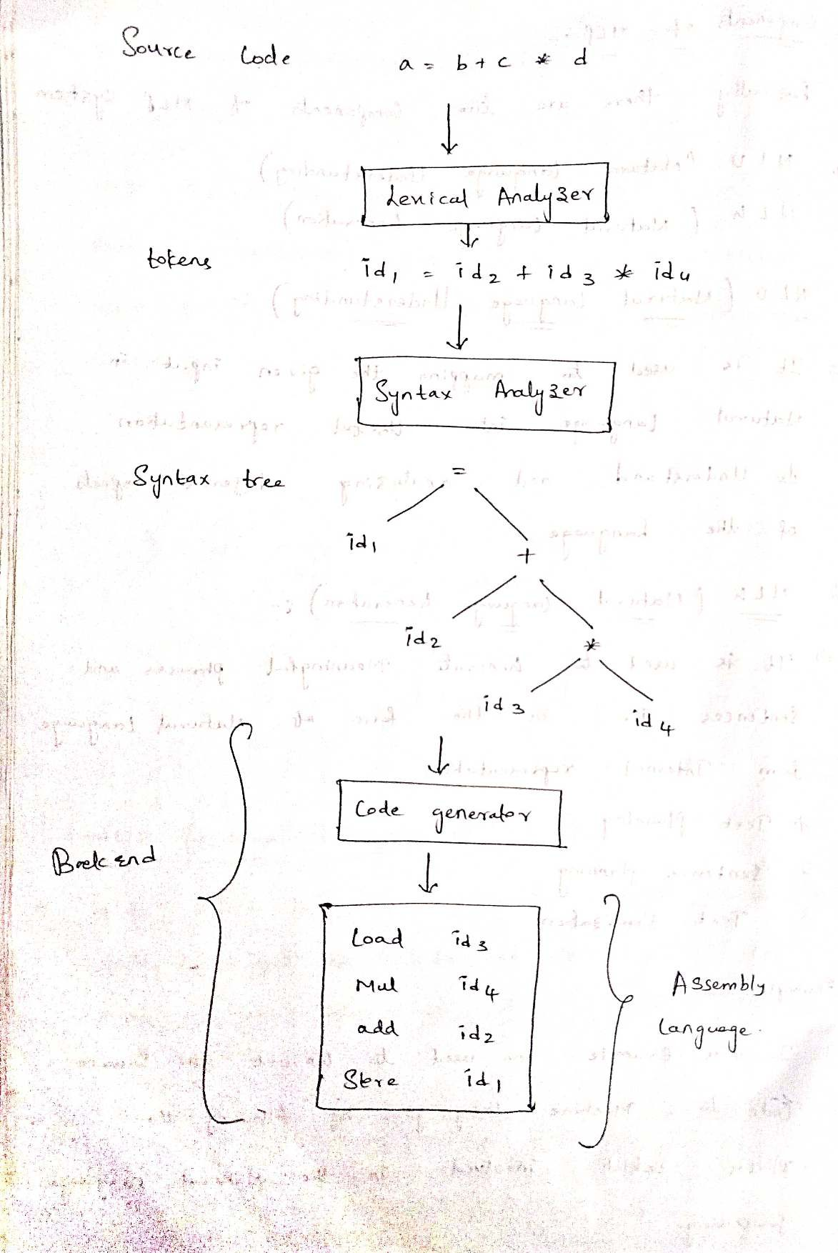

Slide 15
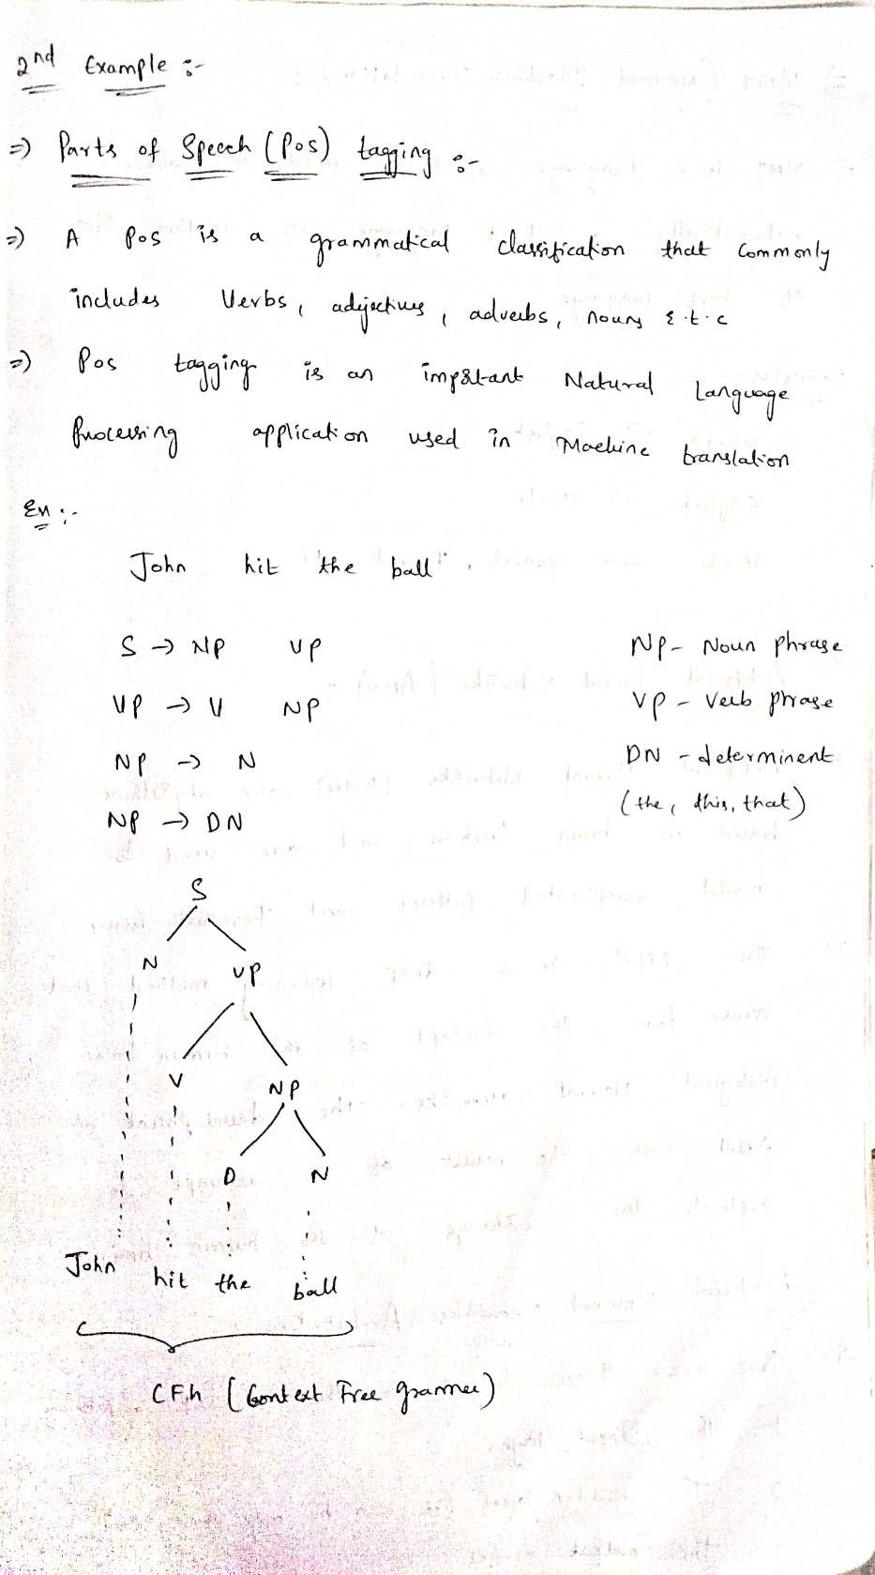

Slide 16

. Question Answering
Question Answering
Question Answering focuses on building systems that automatically answer the questions asked by humans in a natural language.

Slide 17
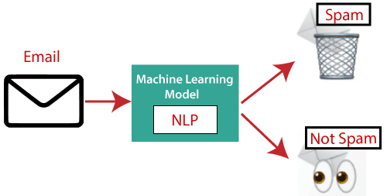
Spam Detection

Slide 18
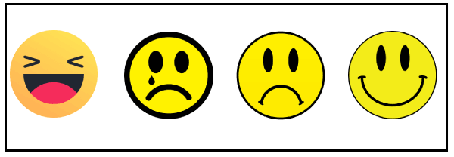
Sentiment Analysis

Slide 19
Machine Translation: English to hindi
Spelling correction:Microsoft Corporation provides word processor software like MS-word, PowerPoint for the spelling correction
Speech Recognition
Chatbot

Slide 20
What is Artificial Neural Network?
The term "Artificial Neural Network" is derived from Biological neural networks that develop the structure of a human brain. Similar to the human brain that has neurons interconnected to one another, artificial neural networks also have neurons that are interconnected to one another in various layers of the networks. These neurons are known as nodes.

Slide 21
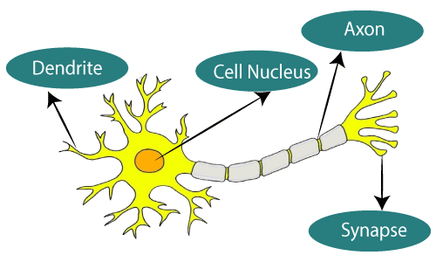
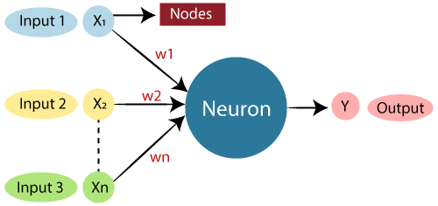
Biological Neural Network | Artificial Neural Network
Dendrites | Inputs
Cell nucleus | Nodes
Synapse | Weights
Axon | Output

Slide 22
. The typical Artificial Neural Network

Slide 23
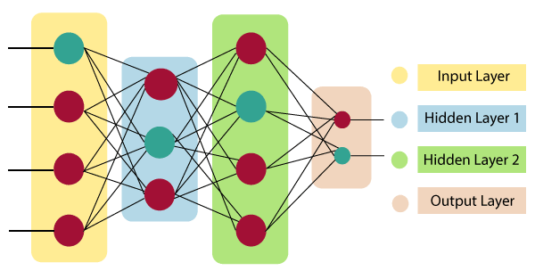
The architecture of an artificial neural network:

Slide 24


Slide 25
Artificial Neural Network primarily consists of three layers:
Input Layer:As the name suggests, it accepts inputs in several different formats provided by the programmer.
Hidden Layer:The hidden layer presents in-between input and output layers. It performs all the calculations to find hidden features and patterns.
Output Layer:The input goes through a series of transformations using the hidden layer, which finally results in output that is conveyed using this layer.
The artificial neural network takes input and computes the weighted sum of the inputs and includes a bias. This computation is represented in the form of a transfer function

Slide 26
What are the types of Artificial Neural Networks?
Feedforward Neural Network: The feedforward neural network is one of the most basic artificial neural networks. In this ANN, the data or the input provided travels in a single direction. It enters into the ANN through the input layer and exits through the output layer So the feedforward neural network has a front-propagated wave only and usually does not have backpropagation.
Convolutional Neural Network: A Convolutional neural network has some similarities to the feed-forward neural network, where the connections between units have weights that determine the influence of one unit on another unit.
But a CNN has one or more than one convolutional layer that uses a convolution operation on the input and then passes the result obtained in the form of output to the next layer. CNN has applications in speech and image processing which is particularly useful in computer vision.

Slide 27
What are the types of Artificial Neural Networks?
Modular Neural Network: A Modular Neural Network contains a collection of different neural networks that work independently towards obtaining the output with no interaction between them. Each of the different neural networks performs a different sub-task by obtaining unique inputs compared to other networks. The advantage of this modular neural network is that it breaks down a large and complex computational process into smaller components, thus decreasing its complexity while still obtaining the required output.
Radial basis function Neural Network: Radial basis functions are those functions that consider the distance of a point concerning the center.
Recurrent Neural Network: The Recurrent Neural Network saves the output of a layer and feeds this output back to the input to better predict the outcome of the layer.

Slide 28
Training Deep Networks
A deep neural network (DNN) is an ANN with multiple hidden layers between the input and output layers.
There can be multiple hidden layers which depend on what kind of data you are dealing with. The number of hidden layers is known as the depth of the neural network.

Slide 29
Data Collection and Preparation:
Gather a dataset that is representative of the problem you want to solve. This data should be divided into training, validation, and test sets.
Preprocess the data by normalizing, scaling, and augmenting it as needed. Data preprocessing helps ensure that the network can learn effectively.
Model Architecture:
Choose an appropriate neural network architecture for your problem. This may involve selecting the type of layers (e.g., convolutional, recurrent, fully connected) and arranging them in a meaningful way.
Determine the number of neurons or units in each layer, the activation functions to use, and any other architectural details.
Loss Function:
Select an appropriate loss function (also known as a cost or objective function) that quantifies the difference between the model's predictions and the actual target values.
Optimizer:
Choose an optimization algorithm (optimizer) that will adjust the model's weights and biases to minimize the loss function. Common optimizers include stochastic gradient descent (SGD), Adam, RMSprop, and others.

Slide 30
Training Loop:
Iterate through the training dataset in batches. For each batch:
Forward pass: Compute predictions for the input data.
Compute the loss using the chosen loss function and the true labels.
Backward pass (backpropagation): Compute gradients of the loss with respect to the model's parameters.
Update the model's parameters using the optimizer.
Validation:
Periodically evaluate the model's performance on a separate validation dataset. This helps monitor the model's progress and detect overfitting
Adjust hyperparameters or stop training if the validation performance does not improve or starts to degrade.
Hyperparameter Tuning:
Experiment with different hyperparameters, including learning rates, batch sizes, network architectures, and regularization techniques (e.g., dropout, L2 regularization) to find the best combination for your problem.
Regularization:
Apply regularization techniques to prevent overfitting. These techniques include dropout, weight decay (L2 regularization), and early stopping.

Slide 31
Data Augmentation:
Augment the training data by applying random transformations (e.g., rotations, flips, crops) to increase the diversity of the training samples and improve generalization.
Monitoring and Logging:
Keep track of training progress by monitoring metrics like loss and accuracy.
Testing:
After training, evaluate the final model on a separate test dataset that it has never seen before to assess its generalization performance.
Deployment:
Once satisfied with the model's performance, deploy it for making predictions on new, unseen data in a production environment.

Slide 32
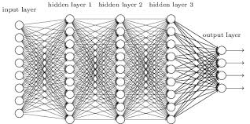

Slide 33
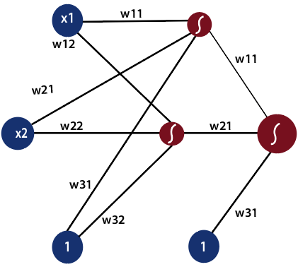
What is a feed forward neural network?
What is a feed forward neural network?
In the feed-forward neural network, there are not any feedback loops or connections in the network. Here is simply an input layer, a hidden layer, and an output layer.

Slide 34
Backpropagation Process in Deep Neural Network
Backpropagation is one of the important concepts of a neural network. Our task is to classify our data best.
For this, we have to update the weights of parameter and bias, but how can we do that in a deep neural network?
In the linear regression model, we use gradient descent to optimize the parameter. Similarly here we also use gradient descent algorithm using Backpropagation.
Backpropagation algorithms are a set of methods used to efficiently train artificial neural networks following a gradient descent approach which exploits the chain rule.

Slide 35
The main features of Backpropagation are the iterative, recursive and efficient method through which it calculates the updated weight to improve the network
Derivatives of the activation function to be known at network design time is required to Backpropagation.

Slide 36
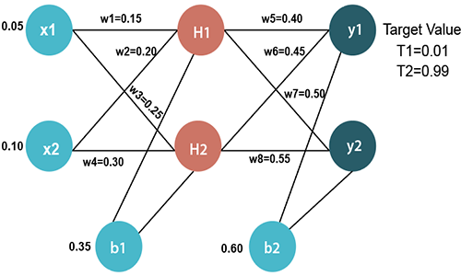
Example

Slide 37
Input values
X1=0.05 X2=0.10
Initial weight
W1=0.15 w5=0.40 W2=0.20 w6=0.45 W3=0.25 w7=0.50 W4=0.30 w8=0.55
Bias Values
b1=0.35 b2=0.60
Target Values
T1=0.01 T2=0.99

Slide 38
Now, we first calculate the values of H1 and H2 by a forward pass.
Forward Pass
To find the value of H1 we first multiply the input value from the weights as
H1=x1×w₁+x2×w₂+b1 H1=0.05×0.15+0.10×0.20+0.35 H1=0.3775
To calculate the final result of H1, we performed the sigmoid function as

Slide 39
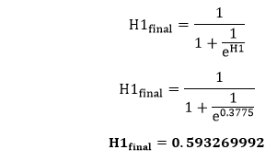

Slide 40
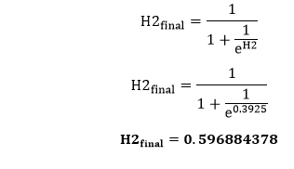
We will calculate the value of H2 in the same way as H1
H2=x1×w₃+x2×w₄+b1 H2=0.05×0.25+0.10×0.30+0.35 H2=0.3925
To calculate the final result of H1, we performed the sigmoid function as

Slide 41
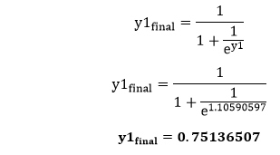
Now, we calculate the values of y1 and y2 in the same way as we calculate the H1 and H2.
To find the value of y1, we first multiply the input value i.e., the outcome of H1 and H2 from the weights as
y1=H1×w₅+H2×w₆+b2 y1=0.593269992×0.40+0.596884378×0.45+0.60 y1=1.10590597
To calculate the final result of y1 we performed the sigmoid function as

Slide 42
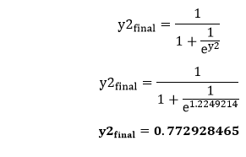
We will calculate the value of y2 in the same way as y1
y2=H1×w₇+H2×w₈+b2 y2=0.593269992×0.50+0.596884378×0.55+0.60 y2=1.2249214
To calculate the final result of H1, we performed the sigmoid function as

Slide 43

Our target values are 0.01 and 0.99. Our y1 and y2 value is not matched with our target values T1 and T2.
Now, we will find the total error, which is simply the difference between the outputs from the target outputs. The total error is calculated as

Slide 44
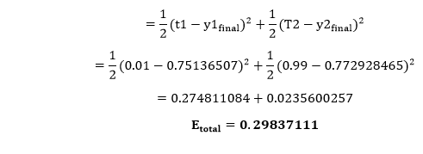
So, the total error is

Slide 45
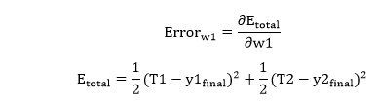
Now, we will backpropagate this error to update the weights using a backward pass.
We will calculate the error at w1 as

Slide 46
In the same way, we calculate w2_{new},w3_{new}, and w4 and this will give us the following values
w1_{new}=0.149780716 w2_{new}=0.19956143 w3_{new}=0.24975114 w4_{new}=0.29950229
We have updated all the weights. We found the error 0.298371109 on the network when we fed forward the 0.05 and 0.1 inputs. In the first round of Backpropagation, the total error is down to 0.291027924. After repeating this process 10,000, the total error is down to 0.0000351085. At this point, the outputs neurons generate 0.159121960 and 0.984065734 i.e., nearby our target value when we feed forward the 0.05 and 0.1

Slide 47
Improving Deep Networks
A Deep Learning Model usually has variable parameters that must be set before training called Hyperparameters. These values affect the results of the model effectively. So the optimal values for these parameters to obtain the best results should be found.
Finding the most optimal combination is called Hyperparameter Tuning.
Hyperparameter tuning can improve a neural network's accuracy and efficiency and is essential for getting good results.

Slide 48
Here are a few methods that can be used to avoid overfitting during Neural Network hyperparameter tuning:
Use a separate validation set to evaluate the model's performance during hyperparameter tuning.
Using regularization techniques, such as weight decay (L2 regularization) or dropout, prevents the model from overfitting to the training data.
Implement early stopping from terminating the training process if the model's performance on the validation set starts to degrade.

Slide 49
Functions for Hyperparameter Tuning
Several approaches can be used to perform hyperparameter tuning on neural networks
Grid search,
Random search, and
Bayesian optimization.

Slide 50
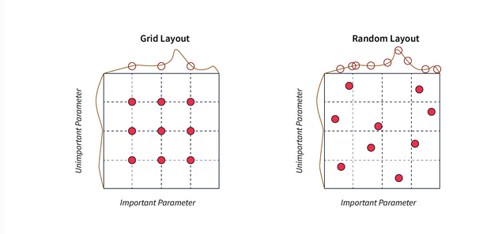

Slide 51
Grid Search
Grid search is a hyperparameter tuning method involving specifying a grid of hyperparameter values and training and evaluating the neural network model for each combination of hyperparameter values.
For example, if we want to tune the learning rate and the batch size of a neural network, we can specify a grid of possible values for the learning rate (e.g., 0.1, 0.01, 0.001) and the batch size (e.g., 32, 64, 128) and train and evaluate the model for each combination of values. The combination of hyperparameters that results in the best results on the validation set is then selected as the optimal set of hyperparameters.

Slide 52
Random search
Random search is another hyperparameter tuning method involving sampling random combinations of hyperparameter values and training and evaluating the neural network model for each combination. Random search can be more efficient than grid search,
Random Search can be better than grid search, especially if the most optimal values for the model are in between the specified values. For example, if the most optimal learning rate is 0.05 and the specified values are 0.01 and 0.1, then the grid search will not give good results, while the random search can get the optimal value.

Slide 53
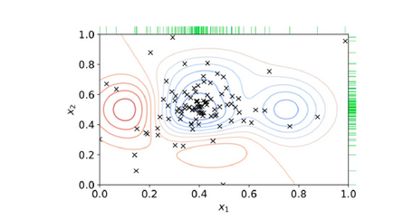
Random Search

Slide 54
Bayesian optimization
Bayesian optimization uses the previous values of scores and probabilities to make an informed decision in the following iterations. Allowing the model to focus on the hyperparameters that can significantly change the results while not focusing on the parameters doesn't affect the result much.
Bayesian optimization can be more efficient than grid search or random search, as it can adaptively select the next set of hyperparameters to evaluate based on the previous evaluations. However, it can be more computationally expensive and require more resources.

Slide 55
Optimization Algorithms For Training Neural Network
Optimizers are algorithms or methods used to change the attributes of your neural network such as weights and learning rate in order to reduce the losses
Gradient Descent
Gradient Descent is the most basic but most used optimization algorithm. It’s used heavily in linear regression and classification algorithms. Backpropagation in neural networks also uses a gradient descent algorithm.
Gradient descent is a first-order optimization algorithm which is dependent on the first order derivative of a loss function. It calculates that which way the weights should be altered so that the function can reach a minima. Through backpropagation, the loss is transferred from one layer to another and the model’s parameters also known as weights are modified depending on the losses so that the loss can be minimized.

Slide 56
Stochastic Gradient Descent
It’s a variant of Gradient Descent. It tries to update the model’s parameters more frequently. In this, the model parameters are altered after computation of loss on each training example. So, if the dataset contains 1000 rows SGD will update the model parameters 1000 times in one cycle of dataset instead of one time as in Gradient Descent.

Slide 57
Regularization
Regularization in deep neural networks is a set of techniques used to prevent overfitting, which occurs when a model learns to fit the training data very closely but performs poorly on unseen data.
Regularization methods aim to encourage the model to generalize better by adding constraints or penalties to the loss function,

Slide 58
L1 and L2 Regularization:
L1 Regularization (Lasso): This adds a penalty term to the loss function that is proportional to the absolute values of the model's weights.
L2 Regularization (Ridge): L2 regularization adds a penalty term to the loss function that is proportional to the square of the model's weights.
Dropout:
Dropout is a regularization technique that randomly deactivates (sets to zero) a fraction of neurons during each forward and backward pass of training. This prevents any single neuron from becoming overly specialized and encourages the network to rely on a more robust set of features.

Slide 59
Early Stopping:
Early stopping is a simple but effective regularization technique. It involves monitoring the model's performance on a validation dataset during training. If the performance starts to degrade (indicating overfitting), training is stopped early to prevent the model from learning noise in the data.
Data Augmentation:
Data augmentation involves creating new training examples by applying random transformations (e.g., rotations, flips, crops) to the existing training data. This increases the diversity of the training set and helps the model generalize better.
Weight Constraints:
You can apply constraints to the weights of the neural network to limit their values.
Noise Injection:
Adding noise to the input data or to the activations of neurons during training can act as a form of regularization. Noise can help the model become more robust to variations in the data.
DropConnect:
Similar to dropout, DropConnect randomly sets a fraction of weights to zero during each forward and backward pass.

Slide 60
Ensemble Methods:
Combining the predictions of multiple neural networks (ensemble learning) can lead to improved performance and act as a form of regularization. Techniques like bagging and boosting can be applied to neural networks.

